Slide 1
Analog voltage control circuit

Slide 2
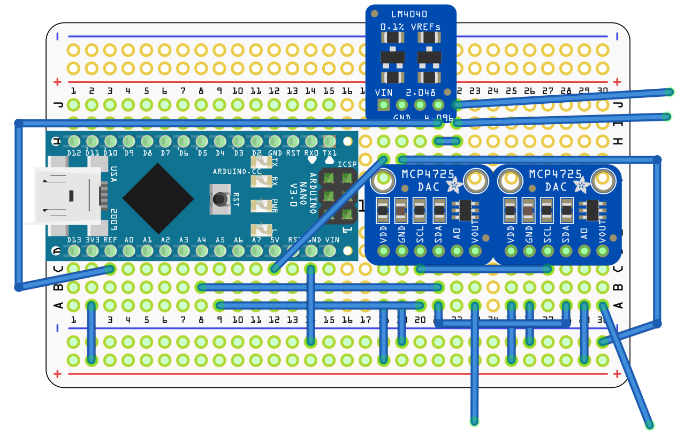

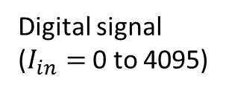



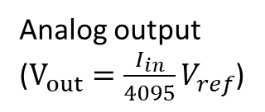

Analog voltage control circuit
$$V_{ref}=4.096$$
$$V_{DD}=3.3V$$
$$V_{out}$$
$$V_{out}$$
Digital signal ($I_{in}=$ 0 to 4095)
Digital-to-Analog Converter (DAC)
Analog output
($V_{out}=\frac{I_{in}}{4095}V_{ref}$)
$$V_{DD}=3.3 V$$

Slide 3
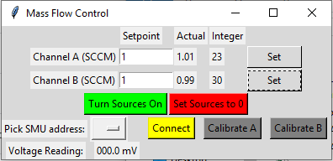
Software
Wrote control software for the Arduino with a python wrapper to allow the flow to be precisely set from the computer. Also wrote keithley functions to calibrate the voltage output and test voltage output stability.

